Slide 2
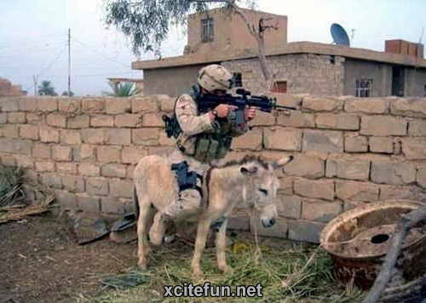
War stories from life insurance actuaries
Presented by Richard Lyon, Grant Peters and Greg Martin

Slide 3
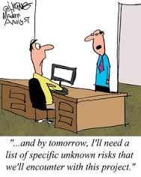
Risk management
Notes:
Greg to lead
Various stories on stupidity and dishonesty. You can’t risk manage these. Need to get your hands dirty and understand/check the coal face/data yourself.
Story on 3LOD issues/flaws.
Stories on culture (links to dishonesty).
Richard to comment
Amusing culture snippet – but underlying message is worth thinking about

Slide 4
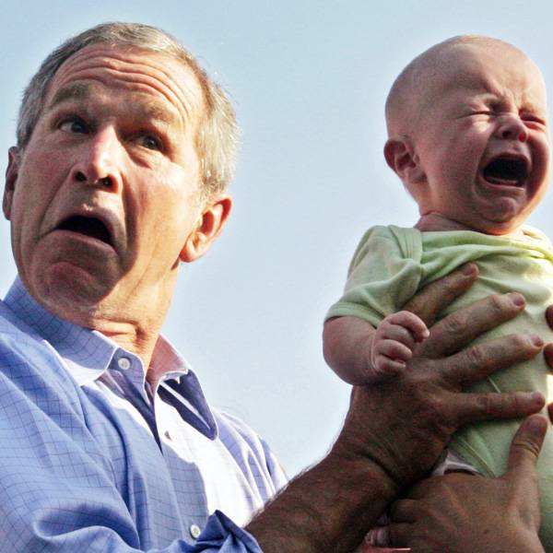
Leadership
Notes:
Richard to lead
Little case history re projecting role of AA
Also story about win-win in reassigning boring tasks
Challenges in implementation of MoS – and will they be repeated with IFRS 17? (Issue is cost of actuarial resource for no obvious business gain, with long-term reputational consequences for actuaries)

Slide 5
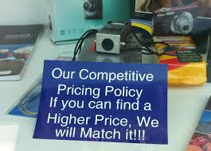
Pricing
Notes:
Greg to lead
Story around group life pricing … and tender winner is the one that makes the mistake! If it looks to good…it usually is.
My AXA unit-linked bond story fits here, I think, but it could also go under risk management
Richard to comment
I can add to Greg’s group life pricing with a very small case history

Slide 6
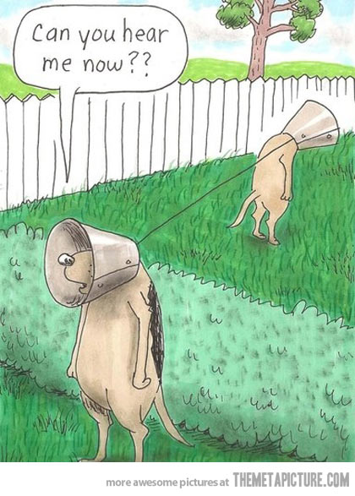
Communication
Notes:
TBC
Greg
Stories on “period 13 adjustment” surprises and damage to reputation/standing of the AA.
Richard
Incidences of “shoot the messenger” when bad news is uncovered and communicated

Slide 7
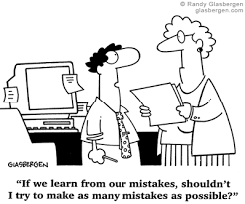
Capital and valuation
Notes:
Greg to lead
Stories on unit pricing, tax, etc. Lack of controls/checks/rec’s.
Story on under capitalisation/cash-flow mortgaging, and its fundamental problems / resilience.
Story on actuaries “owning” assumptions and rose coloured glasses and how that can go wrong.
Richard to comment
Happy to support the “owning assumptions” discussion
Small story about trusting instinct and rule of thumb – if the result really looks wrong and/or you don’t understand it, perhaps it’s not your knowledge/analysis that is deficient

Slide 8
People and relationships
Notes:
Greg
Various stories on this. Confrontational approaches don’t work. Managing assumption changes.

Slide 9
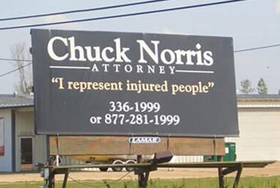
Conflicts of interest
Notes:
Richard
RECOGNISING the impact of the conflict as it develops has been the challenge for me – not sure that it’s really a single packaged story

